Slide 1
Sleep Health Analysis
IRONHACK FINAL PROJECT
Khaled AlYoussef

Slide 2
The purpose of the project
Problem :Sleep quality is one of the main products of a healthy lifestyle. We spend about a third of our lives sleeping — or at least we should. All kinds of food that sparkles in food. Unfortunately, many of us fall short of that goal. According to the National Institutes of Health, insomnia affects about one-third of the general population, making it the most common sleep disorder in the United States. Here's what you need to know about sleep.
Solving the problem : With the development we are witnessing from artificial intelligence, machine learning models can be used and then trained on a set of training data, then tested on a set of test data, and the classifier predicts whether a person has sleep disorder or not based on the data to be entered.

Slide 3
Data features
Person ID: An identifier for everyone.
Gender: The gender of the person (Male/Female).
Age: The age of the person in years.
Occupation: The occupation or profession of the person.
Sleep Duration (hours): The number of hours the person sleeps per day.
Quality of Sleep (scale: 1-10): A subjective rating of the quality of sleep, ranging from 1 to 10.
Physical Activity Level (minutes/day): The number of minutes the person engages in physical activity daily.
Stress Level (scale: 1-10): A subjective rating of the stress level experienced by the person, ranging from 1 to 10.
BMI Category: The BMI category of the person (e.g., Underweight, Normal, Overweight).
Blood Pressure (systolic/diastolic): The blood pressure measurement of the person, indicated as systolic pressure over diastolic pressure.
Heart Rate (bpm): The resting heart rate of the person in beats per minute.
Daily Steps: The number of steps the person takes per day.
Sleep Disorder: The presence or absence of a sleep disorder in the person (None, Insomnia, Sleep Apnea).

Slide 4
Preview of the dataset
Person ID | Gender | Age | Occupation | Sleep Duration | Quality of Sleep | Physical Activity Level | Stress Level | BMI Category | Blood Pressure | Heart Rate | Daily Steps | Sleep Disorder
1 | Male | 27 | Software Engineer | 6.1 | 6 | 42 | 6 | Overweight | 126/83 | 77 | 4200 | No Disorder
2 | Male | 28 | Doctor | 6.2 | 6 | 60 | 8 | Normal | 125/80 | 75 | 10000 | No Disorder
3 | Male | 28 | Doctor | 6.2 | 6 | 60 | 8 | Normal | 125/80 | 75 | 10000 | No Disorder
4 | Male | 28 | Sales Representative | 5.9 | 4 | 30 | 8 | Obese | 140/90 | 85 | 3000 | Sleep Apnea
5 | Male | 28 | Sales Representative | 5.9 | 4 | 30 | 8 | Obese | 140/90 | 85 | 3000 | Sleep Apnea

Slide 5
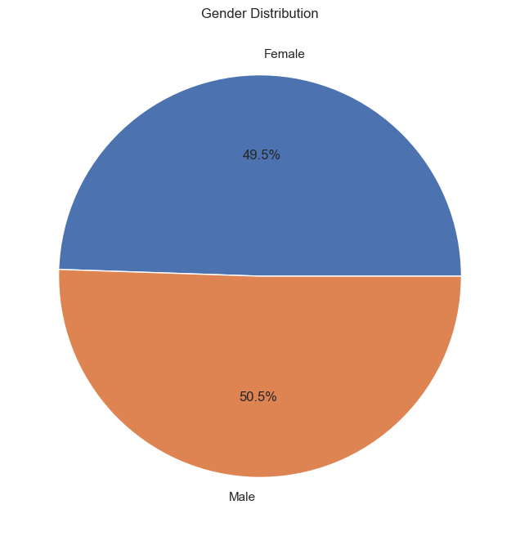
Gender Distribution
The distribution is almost even split which will give us an idea if one gender is more prone to Sleep Disorders or not

Slide 6
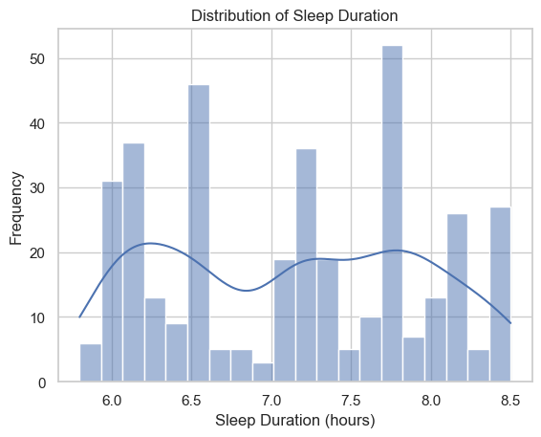
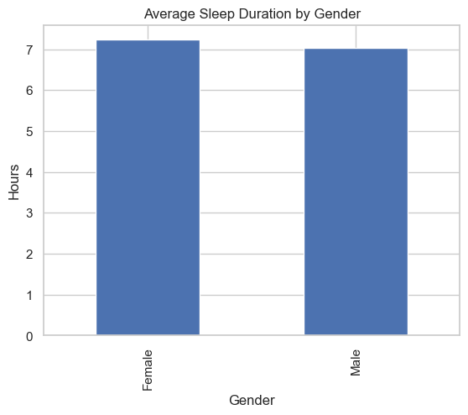
Sleep Duration Distribution

Slide 7
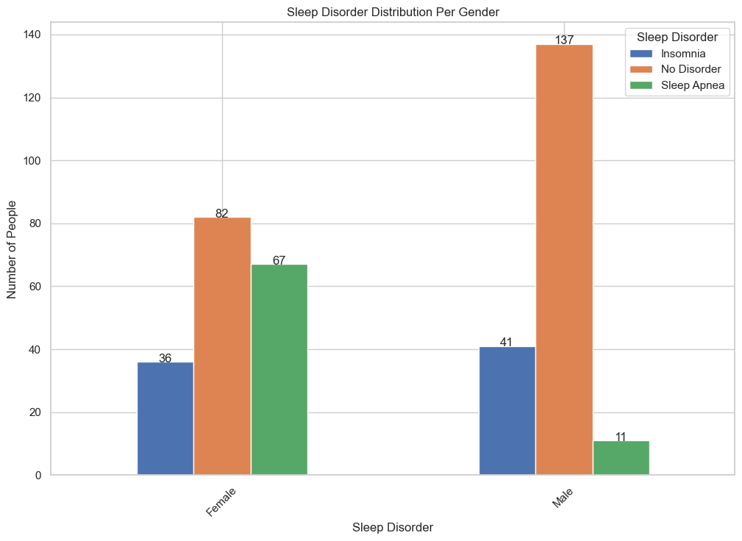

Slide 8
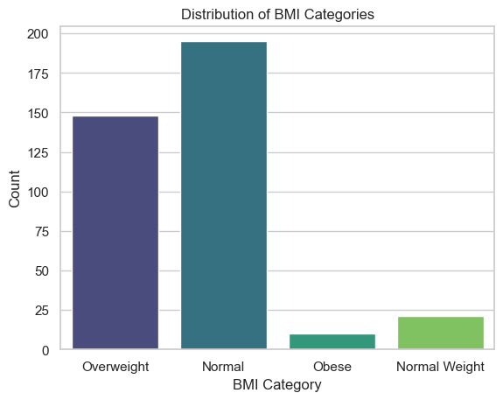

Slide 9
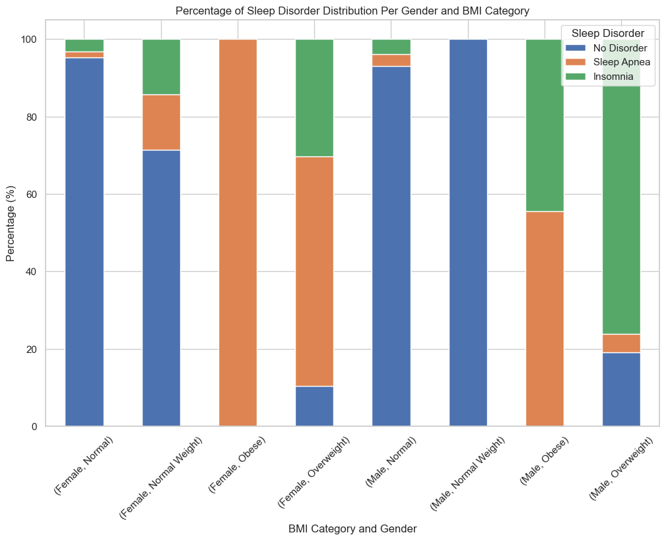

Slide 10
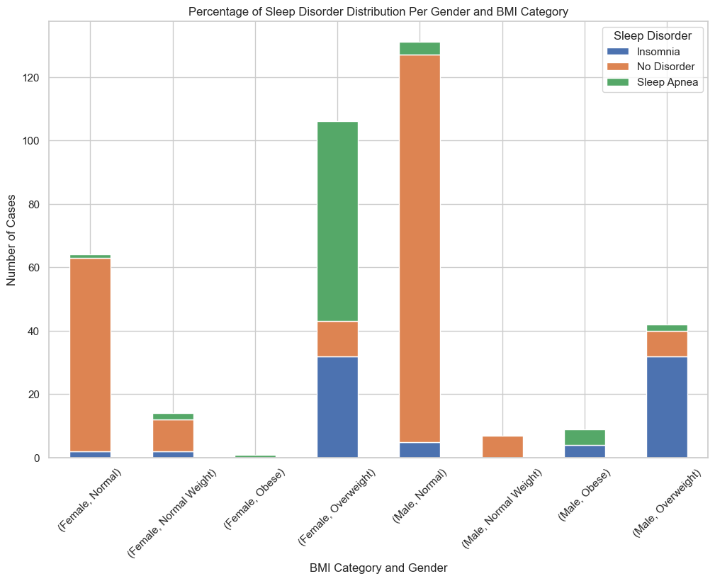

Slide 11
Adjusting the dataset
Person ID | Gender | Age | Occupation | Sleep Duration | Quality of Sleep | Physical Activity Level | Stress Level | BMI Category | Blood Pressure | Heart Rate | Daily Steps | Sleep Disorder | Systolic | Diastolic | BMI Score | Daily Steps Score | Blood Pressure Category | Blood Pressure Score
1 | Male | 27 | Software Engineer | 6.1 | 6 | 42 | 6 | Overweight | 126/83 | 77 | 4200 | No Disorder | 126 | 83 | 3 | 5 | Hypertensive Crisis | 4
2 | Male | 28 | Doctor | 6.2 | 6 | 60 | 8 | Normal | 125/80 | 75 | 10000 | No Disorder | 125 | 80 | 2 | 2 | Elevated | 2
3 | Male | 28 | Doctor | 6.2 | 6 | 60 | 8 | Normal | 125/80 | 75 | 10000 | No Disorder | 125 | 80 | 2 | 2 | Elevated | 2
4 | Male | 28 | Sales Representative | 5.9 | 4 | 30 | 8 | Obese | 140/90 | 85 | 3000 | Sleep Apnea | 140 | 90 | 4 | 5 | Hypertensive Crisis | 4
5 | Male | 28 | Sales Representative | 5.9 | 4 | 30 | 8 | Obese | 140/90 | 85 | 3000 | Sleep Apnea | 140 | 90 | 4 | 5 | Hypertensive Crisis | 4

Slide 12
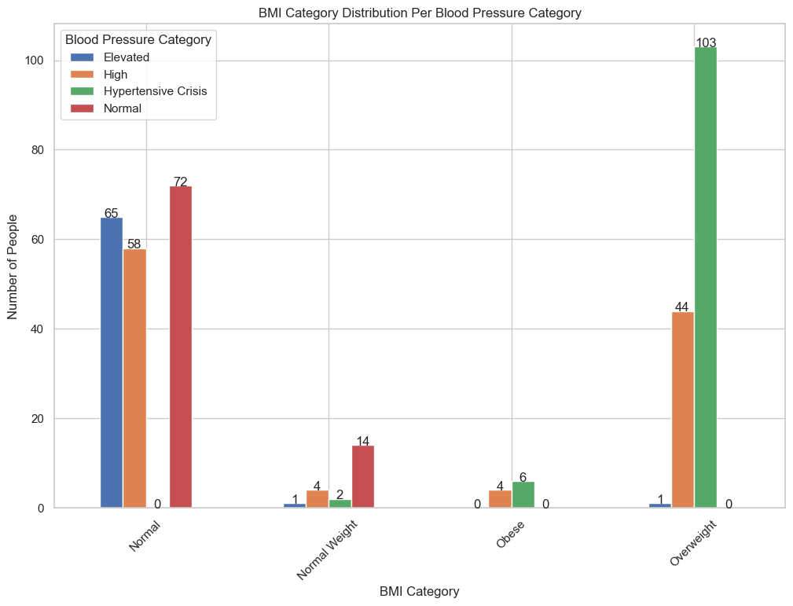

Slide 13
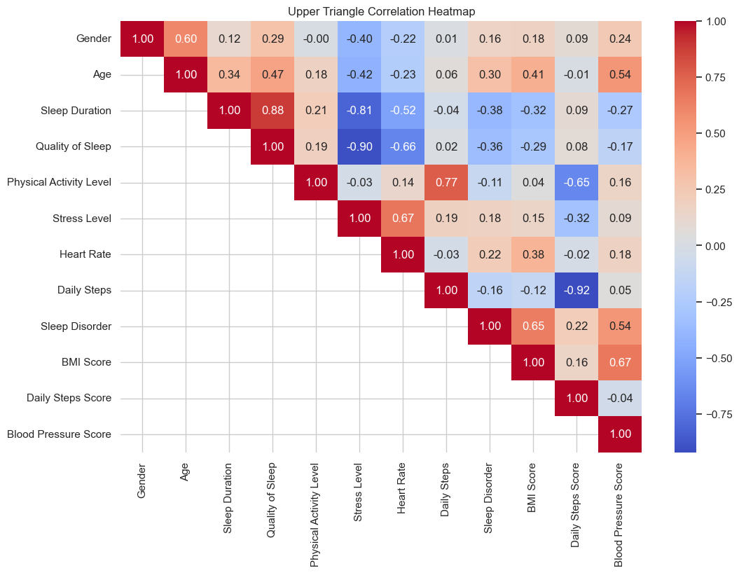
Correlation between the variable and the sleep quality
Strong Positive Correlation:
* Sleep Duration and Quality of Sleep: A strong positive correlation (0.88) exists between these two factors. This suggests that longer sleep duration tends to lead to better sleep quality.
Strong Negative Correlations:
* Quality of Sleep and Stress Level: A strong negative correlation (-0.90) indicates that individuals with better sleep quality tend to experience lower levels of stress.
Moderate Correlations:
* Age and Quality of Sleep: A moderate negative correlation suggests that as age increases, sleep quality may decline.

Slide 14
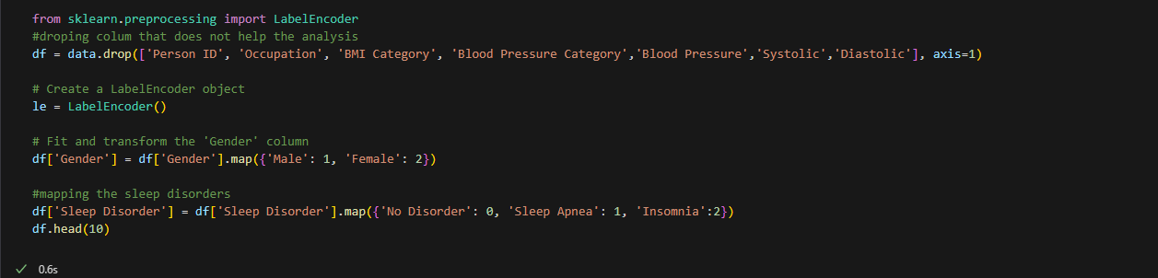
Label Encoding

Slide 15
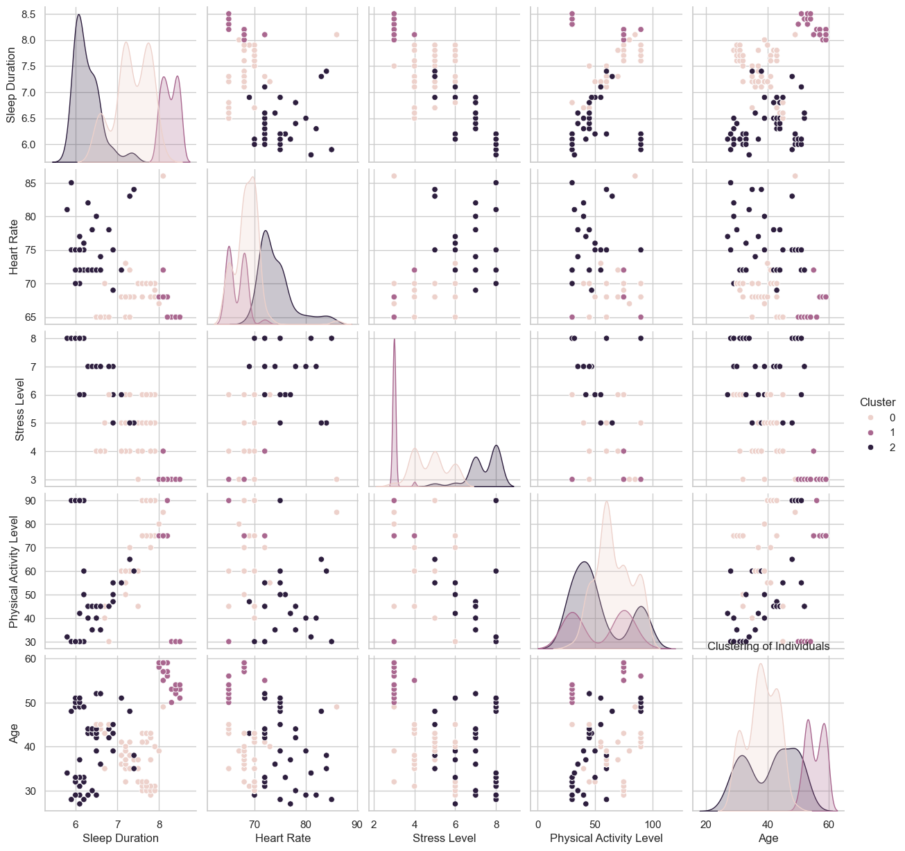
Advanced Clustering K-Means Clustering on Sleep and Lifestyle Factors
The analysis highlights the following key relationships with sleep quality:
Sufficient sleep duration (7-8 hours) and higher physical activity positively impact sleep quality.
Stress levels and heart rate are inversely correlated with sleep quality.
Age and associated lifestyle patterns influence sleep outcomes, particularly for older individuals.
Improving sleep quality requires addressing multiple factors, such as increasing physical activity, managing stress, and ensuring adequate sleep duration.

Slide 16
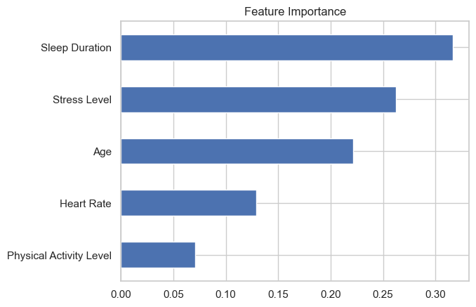
Feature Importance
Using Random Forest to Identify Key Predictors of Sleep Quality with 20% sample size:
Overall Accuracy:
The model achieves an accuracy of 97% over the entire dataset of 75 samples, which is excellent.
Macro Average:
The macro average is 0.98 for precision, recall, and F1-score. This indicates balanced performance across all classes, regardless of their size.
Weighted Average:
The weighted average considers the support (number of instances per class) and gives an overall score of 0.98 (precision), 0.97 (recall), and 0.97 (F1-score).
This reflects excellent overall model performance.

Slide 17
Sleep Duration?
Generally speaking, Sleep Duration does not always lead to better. However, most of the time more time sleeping is related to better quality sleep.
For the sake of this analysis, all the rest for the studies are done twice, one with Sleep Duration included and one without it, in order to see if there a notable impact or no

Slide 18
Logistic regression
The SP Model demonstrates superior performance across all key metrics (accuracy, precision, recall, F1-score). This suggests that the SP model is likely a more robust and reliable classifier for this particular dataset.
Metric | With SP | Without SP
Accuracy | 93% | 87%
Precision (Class 0) | 91% | 85%
Precision (Class 1) | 97% | 89%
Recall (Class 0) | 98% | 93%
Recall (Class 1) | 88% | 78%
F1-score (Class 0) | 94% | 89%
F1-score (Class 1) | 92% | 83%

Slide 19
Linear Regression
 | With SP | Without SP
Mean Squared Error: | 0.129733727 | 0.172224247
R-squared: | 0.91400516 | 0.885840044
Feature Coefficient
Sleep Duration | 0.642969 | N/A
Heart Rate | -0.039616 | -0.038215
Stress Level | -0.280201 | -0.516166
Physical Activity Level | 0.005527 | 0.010167
Age | 0.014145 | 0.012336
Model Performance: The model including "SP" exhibited better performance with lower Mean Squared Error (MSE) and slightly higher R-squared, indicating better predictive accuracy and a greater proportion of explained variance.
Feature Effects: Sleep Duration: Had a strong positive impact on the outcome in the model with "SP," while its effect was not captured in the model without "SP."
Stress Level: Exerted a stronger negative influence on the outcome in the model without "SP."
Heart Rate, Physical Activity Level, and Age: Showed consistent, albeit weak, effects across both models.

Slide 20
Random Forest Regressor
MSE This suggests that the model without SP might be making slightly more accurate predictions on average.
R-squared: Both models have very high R-squared values, meaning they explain a large portion of the variability in the data. The model without SP has a slightly higher R-squared (0.99043) compared to the model with SP (0.989423).
Adjusted R-squared: Similar to R-squared, the model without SP has a slightly higher adjusted R-squared (0.989883) compared to the model with SP (0.988489).
Metric | With SP | Without SP
Mean Squared Error | 0.015957 | 0.014437
R-squared | 0.989423 | 0.99043
Adjusted R-squared | 0.988489 | 0.989883

Slide 21
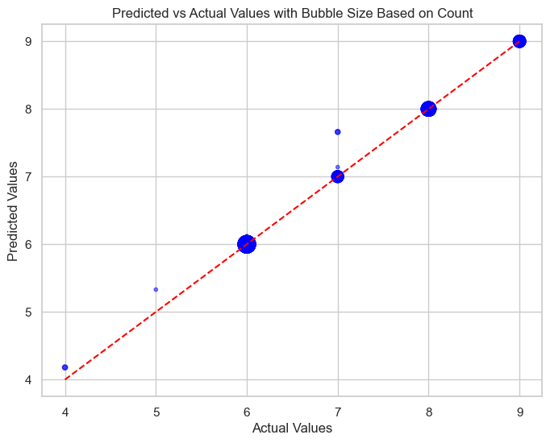
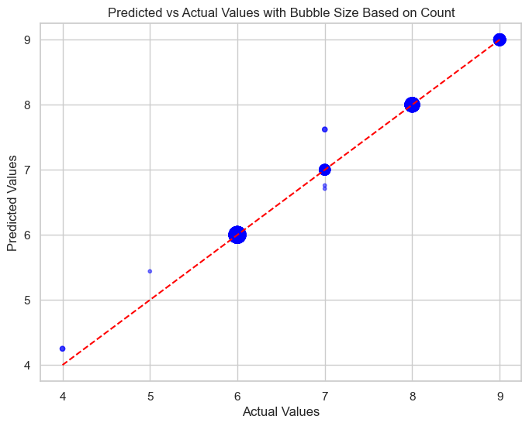
Predicted Vs Actual
This plot visualizes the relationship between the actual values of our target variable and the values predicted by our model.

Slide 22
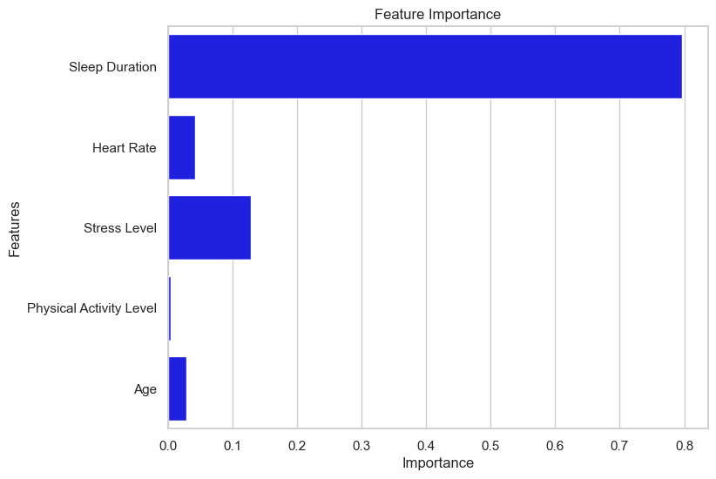
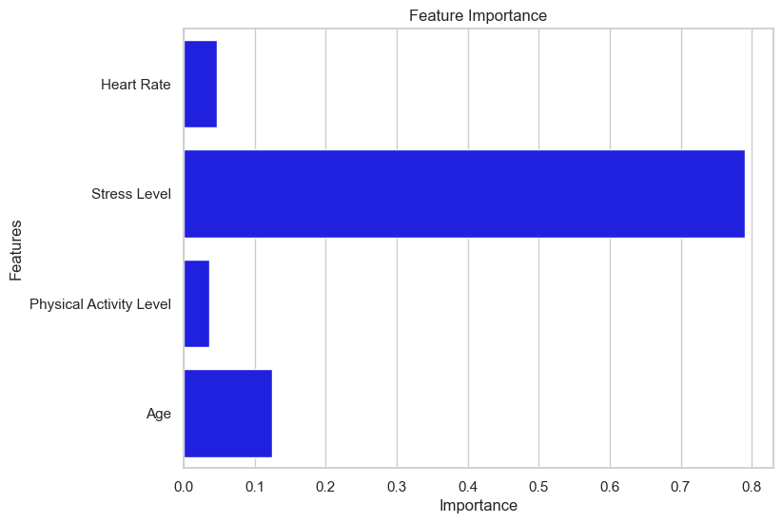
Feature Importance
This plot visualizes the impact for each variable to Sleep Quality

Slide 23
THANK YOU

